Slide 1
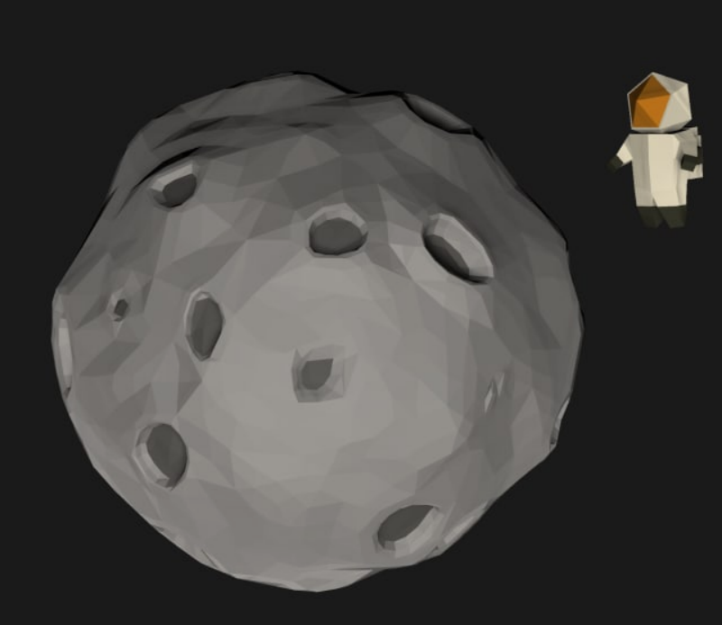
SpaceFormer69: To the Moon (a Prequel to the beloved classic)
Michael Berezovsky, Nikita Zotikov, Ivan Rozhdestvenskii
Technische Universität München,
Games Engineering,
Winter Semester 21/22
Spaceformer69

Slide 2


Introduction
Idea: choose a random game jam theme as an inspiration
Result: “Recycling” from Ludum Dare 48

Slide 3
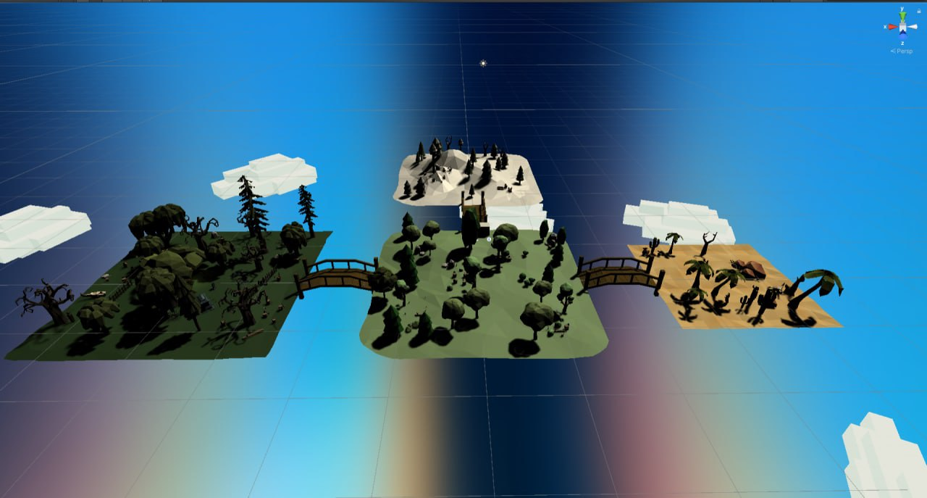
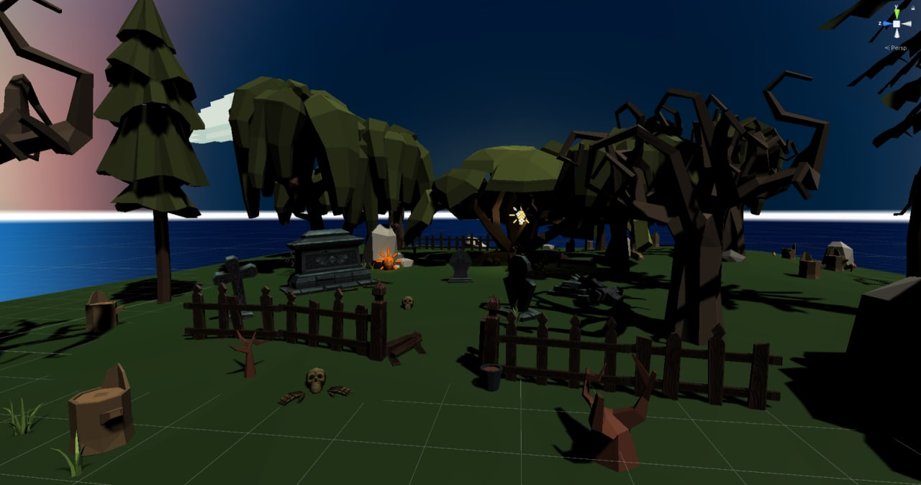
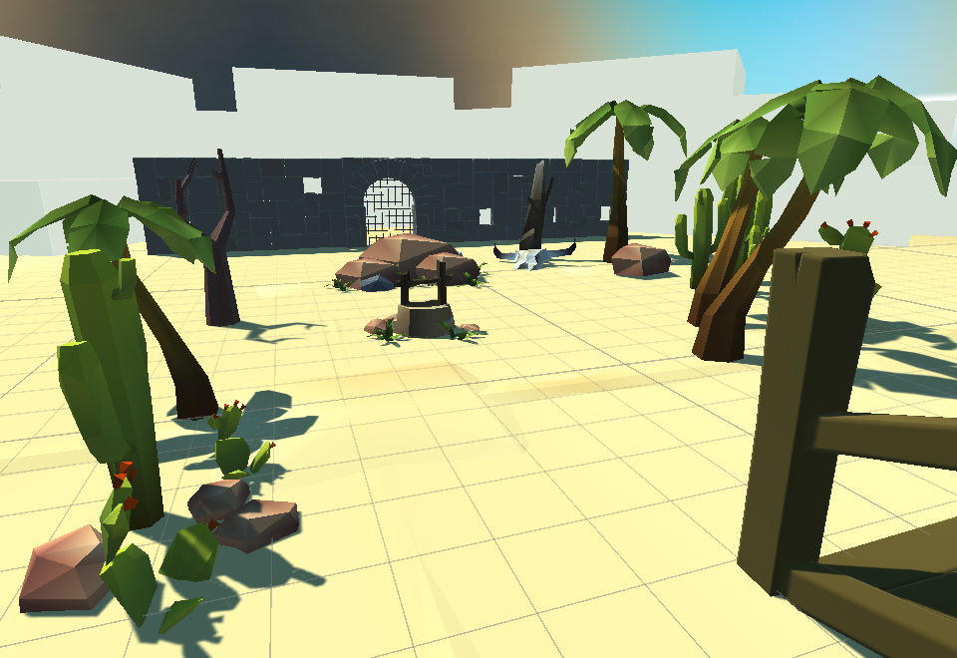
HIGH-LEVEL CONCEPT #1
Brainstorming process:
Puzzle game (Sokoban)?
Real-time strategy (Factorio) ?
3D Platformer (Spaceformer69)?
Adventure (The Witness)?
RESULT: Adventure game with puzzles!

Slide 4



HIGH-LEVEL CONCEPT #2
Main goal:
Collect garbage
Recycle it into the parts of a rocket
Assemble the spacecraft
Get out from the island

Slide 5
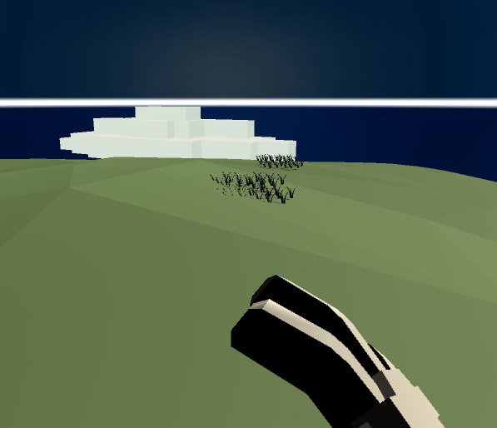
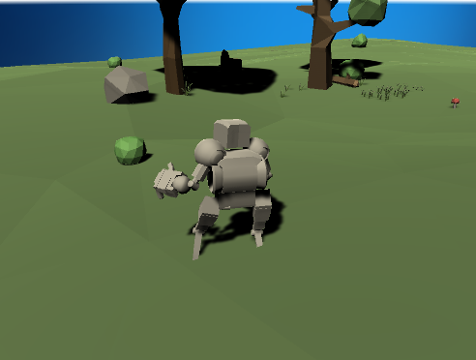
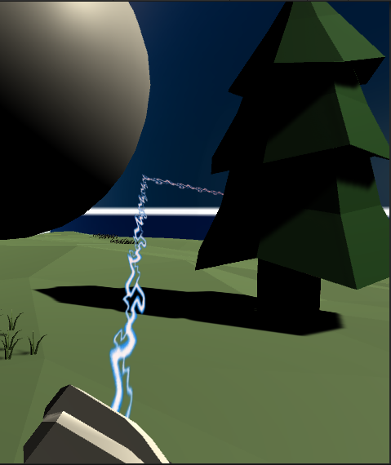
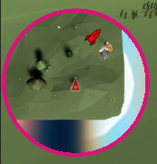
HIGH-LEVEL CONCEPT #3
Features
Swap between First- and Third Person view
Wayfinding (hologram path and minimap)
First Person View
Third Person View
Hologram path
Minimap

Slide 6
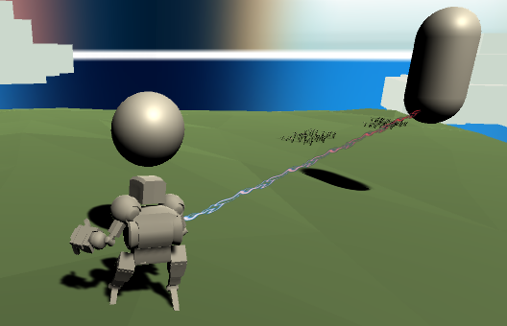
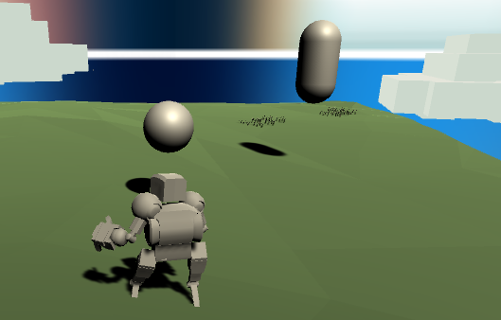
HIGH-LEVEL CONCEPT #4
Congratulations on beating the game!
It took you 01:09:00
to build the rocket and get out!
Features
One world with various locations
Some parts are hidden behind puzzles
Pick up & Throw objects
Timer to compare your time against your friends
Timer
Pick Up & Throw objects

Slide 7
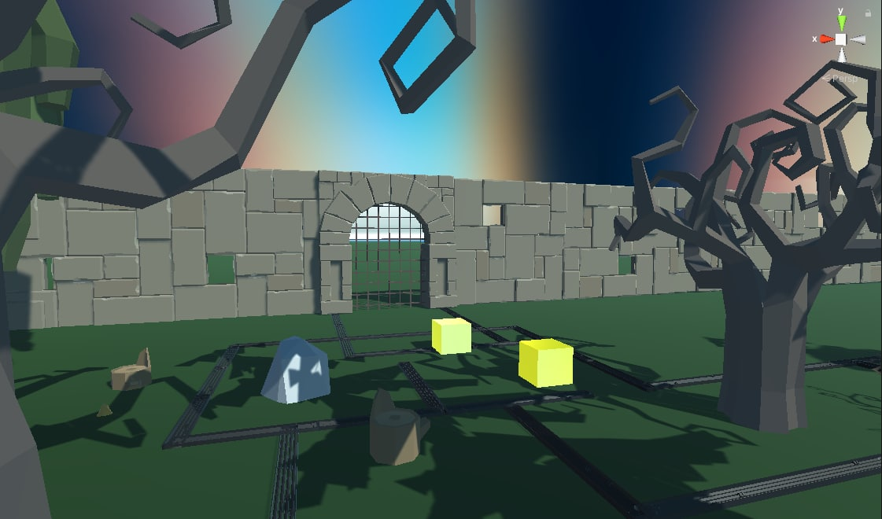
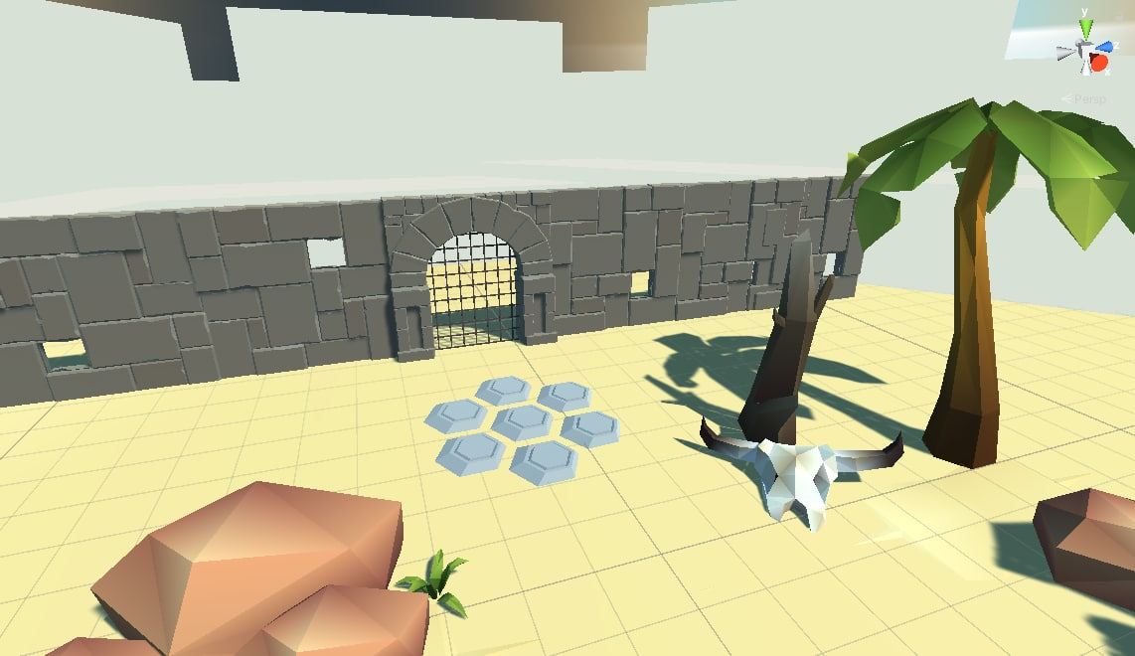
HIGH-LEVEL CONCEPT #5
Puzzles

Slide 8

Implementation
Implementation
1. Unity Engine + C# Scripts
2. AI (NavMesh)
3. Unity’s New Input System

